Slide 1
TYPES OF COMPUTER CASES
By: Abdul Mateen

Slide 2
WHAT IS A COMPUTER CASE?
A computer casr is the enclosure that houses the main components of a computer. It provides protection, ventilation, and structure to the system.

Slide 3
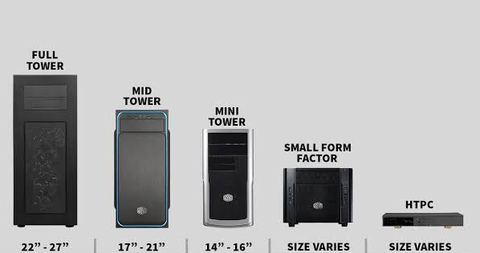
Types of Computer Cases
Full Tower
Mid Tower
Mini Tower
Small Form Factor (SFF)
HTPC (HOME THEATER PC)

Slide 4
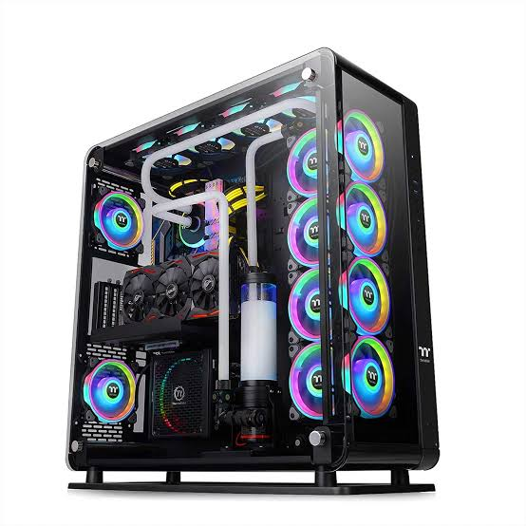
1)Full Tower
Size: Large (22-27 inches
USES:
• Ideal for high-performance Like gaming
servers, and 3D Designing. • Can support multiple graphics cards.
• Advanced cooling systems,
and large Storage Setups. PROS:
Excellent Air Flow
CONS:
Takes up Alot of Space

Slide 5
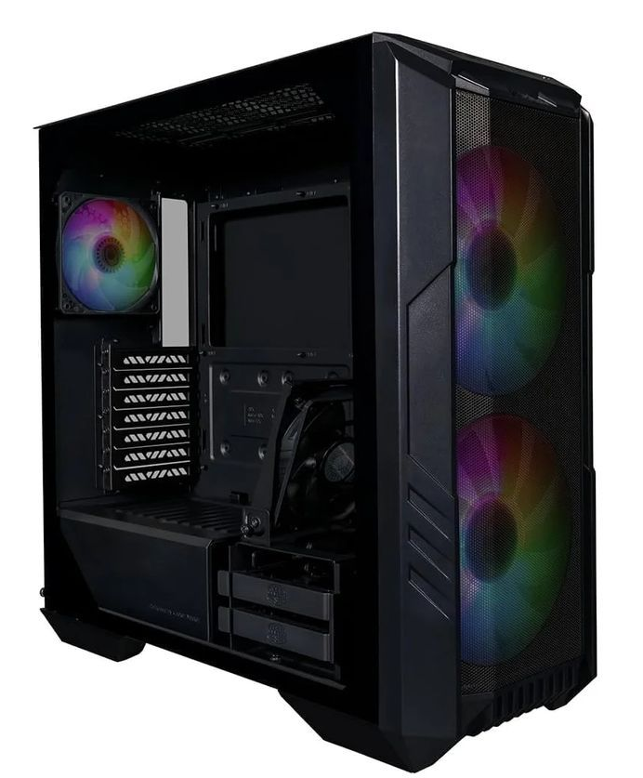
2)Mid Tower Size: Medium (18-22 inches tall) Uses: • The most common choice for general users. • Suitable for most gaming Setups, home, and office PCs. • Offers a good balance between size and expandability. PROS: • enough for most setups. • Easier to handle than full towers. Cons: •Limited space for very high-end setups.

Slide 6
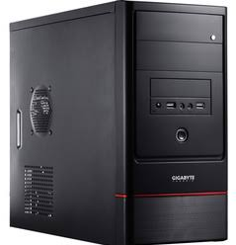
3) Mini Tower Size: Small (14-18 inches tall) Uses: • Ideal for budget or entry-level PCs. • Suitable for basic tasks like browsing,
office work, and light gaming. •Limited expansion options. Pros: • Compact and space-saving. • Easy to move around. Cons: • Poor airflow and limited internal space.

Slide 7
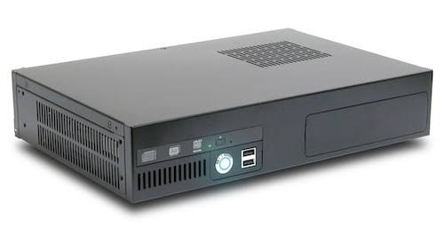
4)Small Form Factor (SFF) Case Size: Very Small Uses: • Ideal for compact workstations, minimalist setups, and portable systems. • Often used in corporate environments and for lightweight gaming PCs. Pros: • Highly portable. • Fits in small spaces. Cons: • Limited expandability and cooling options.

Slide 8
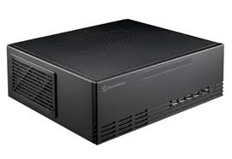
5) HTPC (Home Theater PC) Cases Size: designed to fit in home entertainment systems. Uses: • Designed to sit with other entertainment devices like a DVD player or console. • Used for media streaming, gaming, or home theater systems. Pros: • Blends in with home entertainment systems. Cons: • Limited expansion options and cooling.

Slide 9
Choosing the Right Case Factors to Consider: 1. Purpose: Gaming, office work, media streaming, etc.
2. Budget: Larger cases tend to be more expensive. 3. Space: How much room you have for the case. 4. Aesthetics: RGB lighting, glass panels, and design preferences.

Slide 10
THANK YOU GUYS 😊

